Slide 1
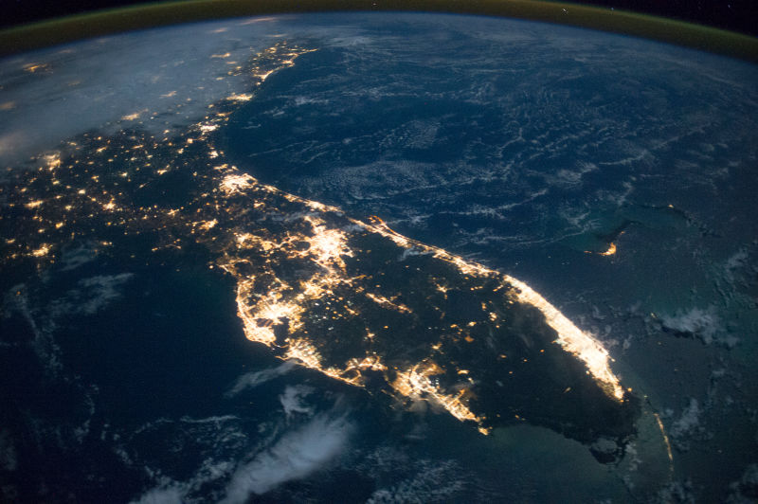

The Florida 2030 Blueprint
What Is It and How Can Local Chambers Get Involved?

Slide 2
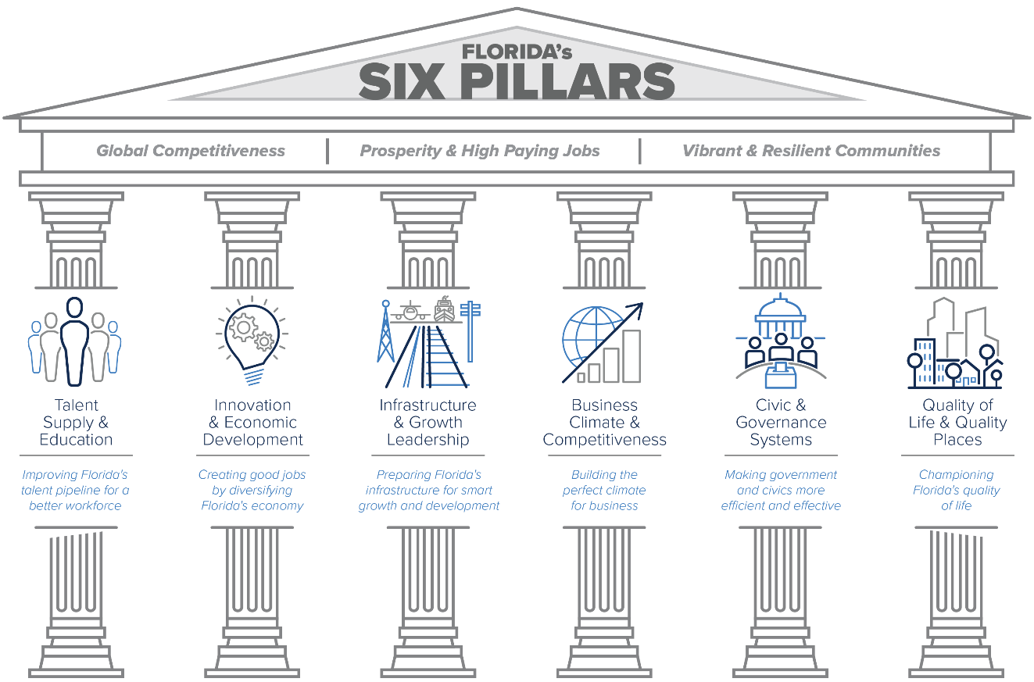
What is Florida 2030?

Slide 3
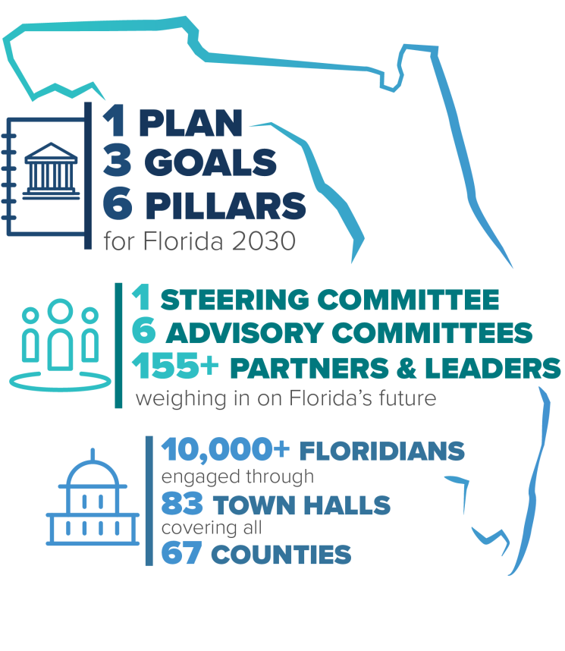
What is Florida 2030?

Slide 4
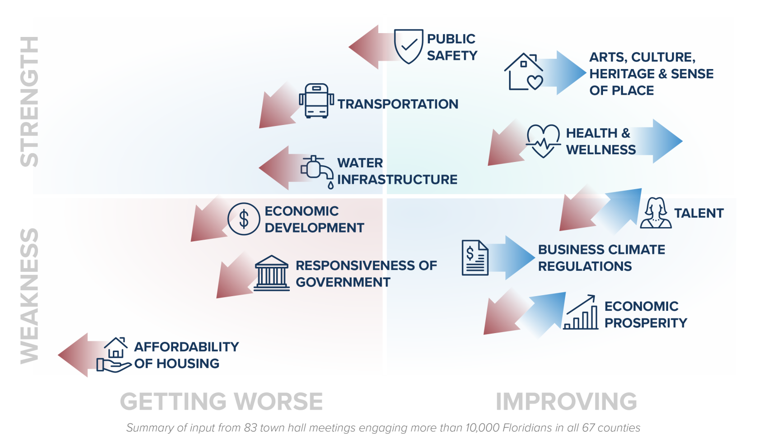
What is Florida 2030?

Slide 5
39 GOALS
Florida Chamber 2030 Goal Partners:
FEDC
Florida Makes
Florida Philanthropic Network
Regional Planning Councils
The Children’s Movement
Volunteer Florida, and more
Download @ www.Florida2030.org
(pages 2-3)

Slide 6


Slide 7
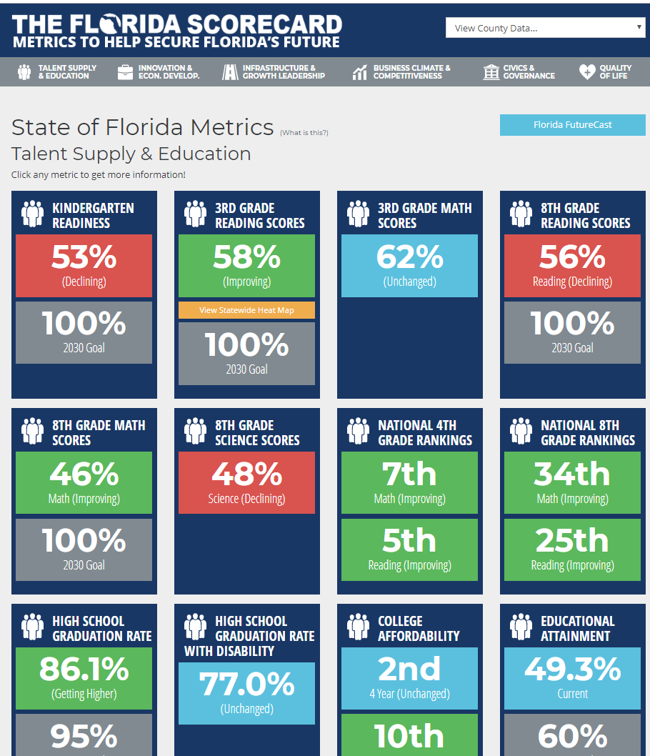
Tracking Florida 2030 Goals
Visit www.TheFloridaScorecard.org

Slide 8

Tracking Florida 2030 Goals – Education Pillar
Visit www.TheFloridaScorecard.org
Sort by your county
Sort by the “Six Pillars”
Getting Worse
Getting Better
Unchanged
2030 Goal

Slide 9
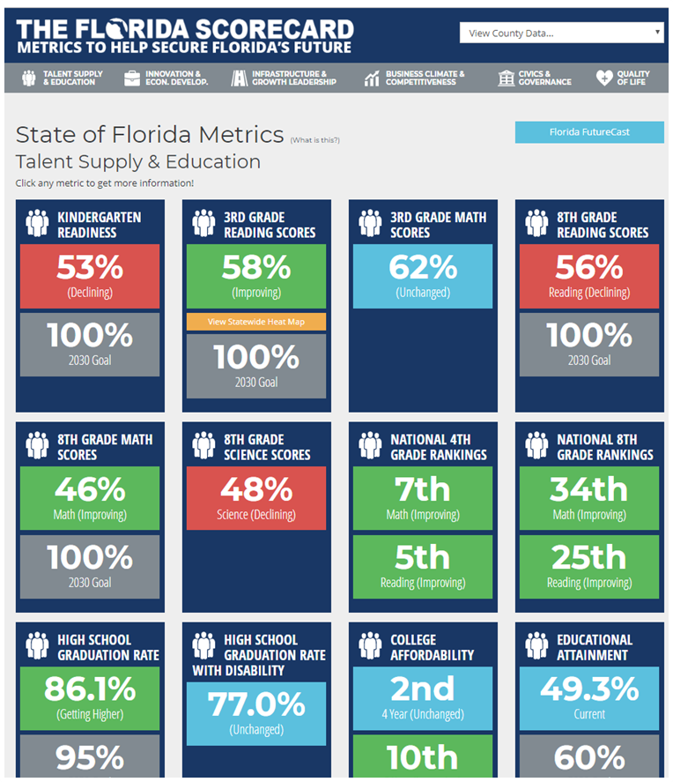
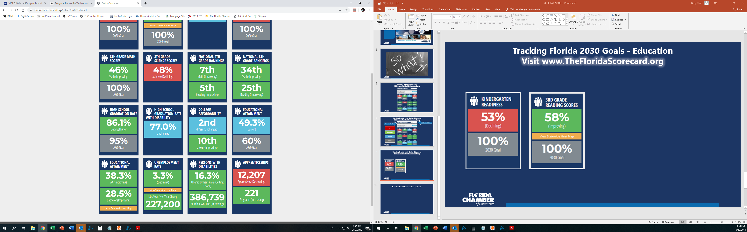
Tracking Florida 2030 Goals - Education
Visit www.TheFloridaScorecard.org

Slide 10
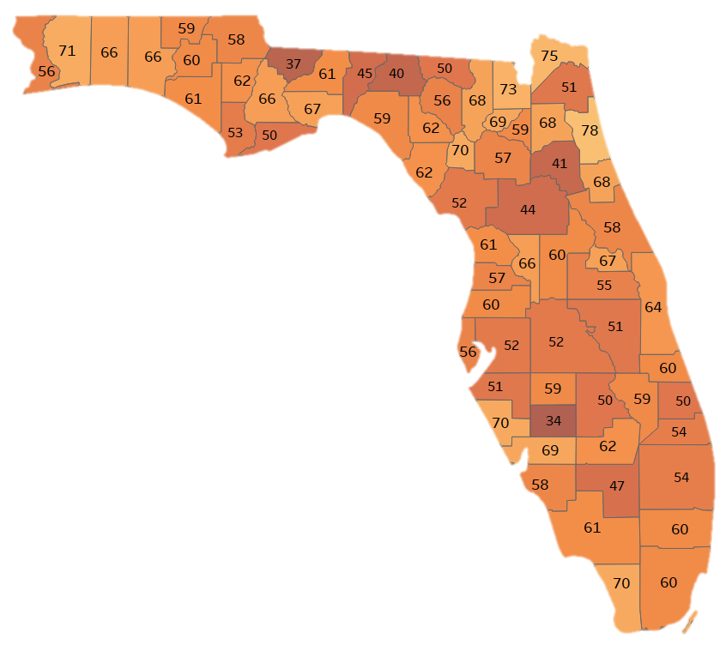
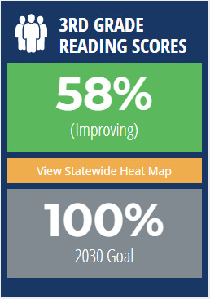
Florida’s 3rd Grade Reading Scores
91,066 3rd graders not reading at grade level
6,713
Top Counties Bottom Counties
1. St. Johns 78 1. Desoto 34
2. Nassau 75 2. Gadsden 37
3. Baker 73 3. Madison 40
4. Santa Rosa 71 4. Putnam 41
Sarasota 70 5. Marion 44
Monroe 70 6. Jefferson 45
Gilchrist 70 7. Hendry 47
Statewide

Slide 11
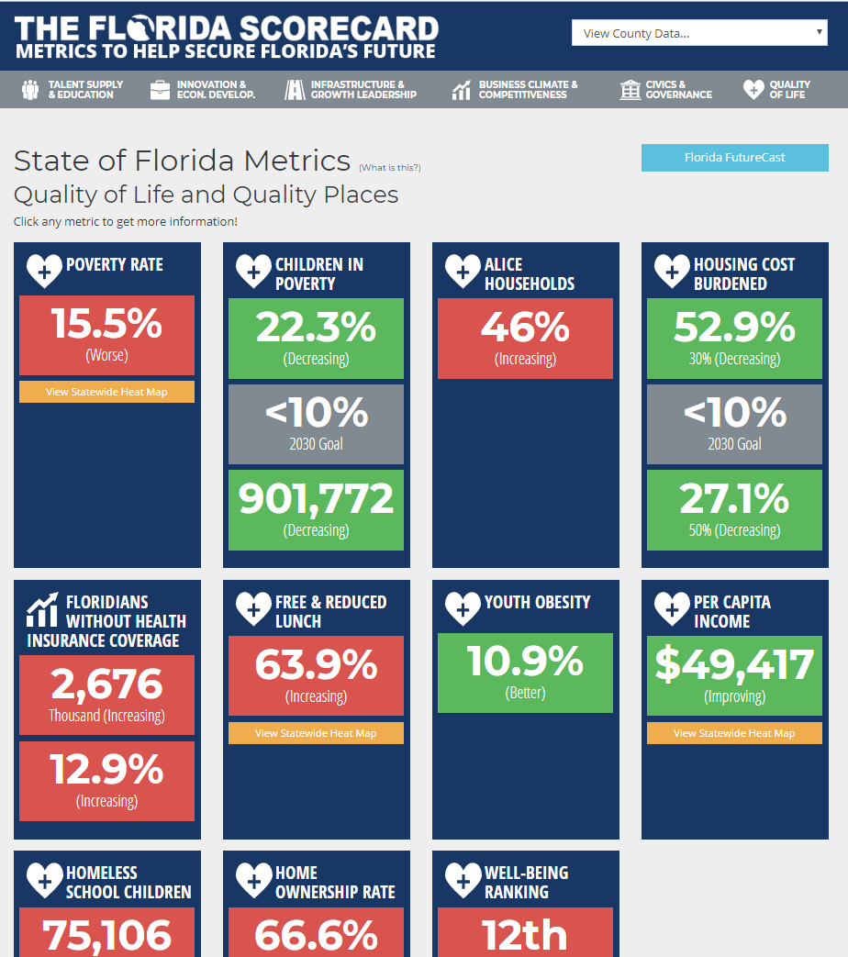
Tracking Florida 2030 Goals – Quality of Life Pillar
Visit www.TheFloridaScorecard.org
Sort by your county
Sort by the “Six Pillars”
Getting Worse
Getting Better
Children in Poverty
Unchanged
2030 Goal

Slide 12
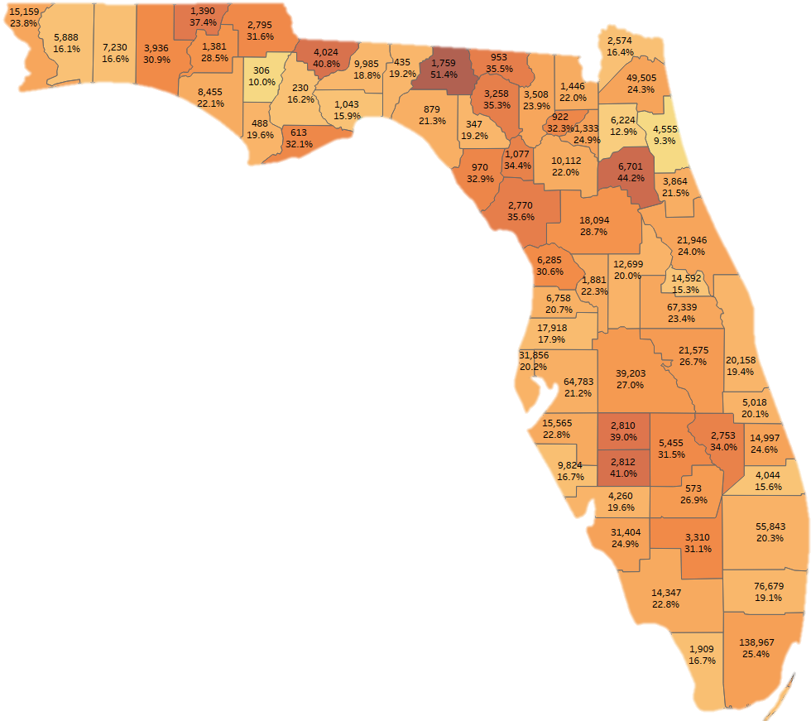
Under-18 Poverty in Florida
There are 901,772 kids living in Poverty in Florida
Florida’s under-18 Poverty rate: 22.3%
Top Number: Kids living in Poverty
Bottom Number: Under-18 Poverty Rate
Data Source: American Community Survey, U.S. Census Bureau

Slide 13
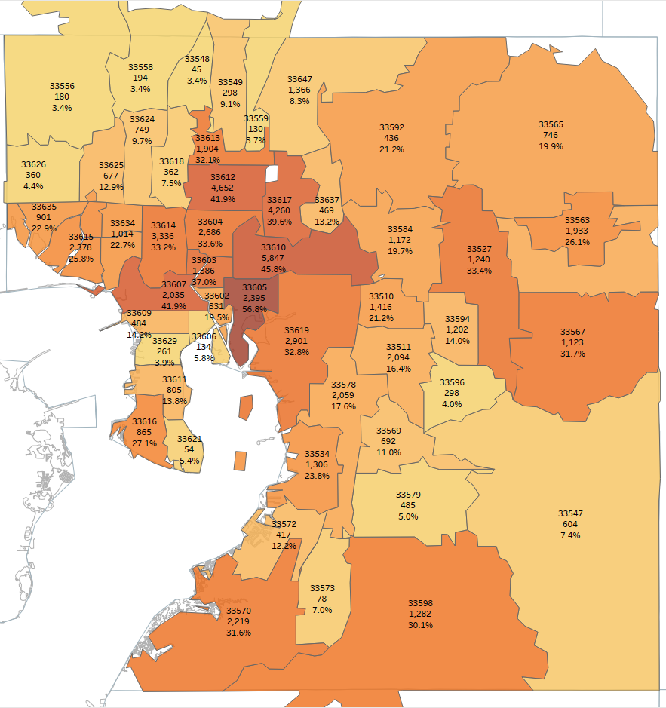
Hillsborough County Florida
901,772 kids in poverty in Florida – 22.3%
64,783 kids in poverty in Hillsborough County – 21.2%
Under-18 Poverty by Zip Code
Top Number: Zip Code
Middle Number: Number of kids in poverty
Bottom Number: Under-18 poverty rate
Heat map on Under-18 poverty rate
Data Source: American Community Survey,
U.S. Census Bureau, 2017 data.

Slide 14
How Can Local Chambers Get Involved?
Which of the 39 goals do your members/community care about?
We want to engage your chamber and individuals/organizations in your community!

Slide 15
How Can Local Chambers Get Involved?
Next Steps
Regional leaders will be chosen.
Regional conversations will happen.
Good News: Still early in the process.

Slide 16
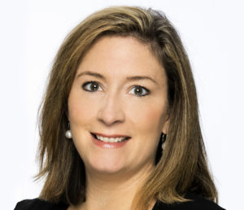
Donna Wright
Chief Operations Officer
Florida Chamber Foundation
850-521-1252
DWright@FLFoundation.org

Slide 17

Continue the Conversation
Join us at the Future of Florida Forum
Register at: FloridaChamber.com/events

Slide 18
Greg Blosé
Board of Governors Program Director
gblose@flchamber.com
850.521.1243

