Slide 1
Lesson Learned From a Cat 5 Storm
Notes:
Good afternoon! I am Elizabeth Smith, Vice President of Events and Foundation for the Bay County Chamber. Thank you for having me. Carol sends her apologies for not being able to attend.
I want to start off and go through this by telling our story of what we learned and what we went through before and after Hurricane Michael. I know all of us in here gone through so much within the past few months.
----Weekend Before the Storm – My POV

Slide 2
Preparedness
Planning
Education
Relationship Building
Notes:
Each year, we take opportunities to educate our community and our members the importance of planning. We do this by promoting the importance of planning ahead with our county officials. We use all of our social media tools, emails and website. The county has developed software, the Continuity of Operations which is a template where businesses go input invaluable information, all in one location. We have handed thousands of discs out to businesses as well as hosted a link on our website.
Each year, we also host free workshops with our Emergency Center of Operations to bring our business community to the table and learn what to do in case of emergency. Our staff also participates in a county hosted “mock” disaster. We gather at our EOC, and “activate for a disaster”. This is a 2-day exercise that all of our utility companies, schools, chambers of commerce, tourism and government participate in. During this time, the county will also issue badges so you may re enter the county before they open it back up for residents. It is also very important to know what the re entrance plan is if you choose to evacuate.
The biggest tool in our tool box has always been our relationships that we have built with our elected officials. This includes our local, state and federal officials and their staffers.

Slide 3
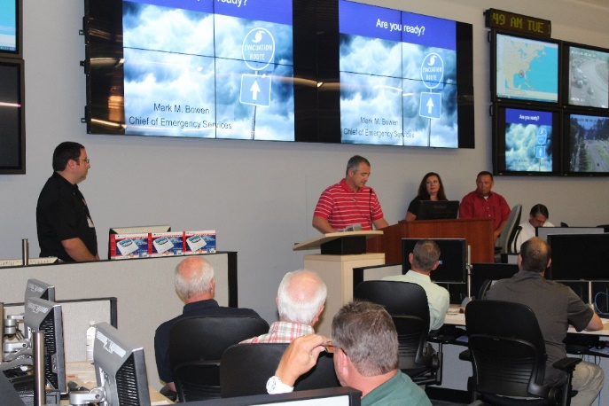
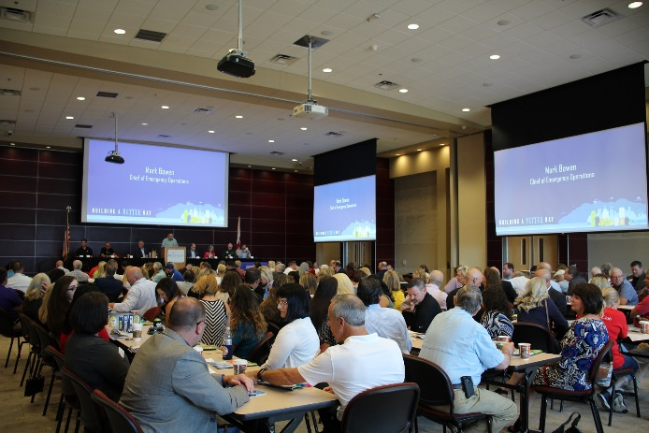
Notes:
These are just a few snapshots of seminars and trainings that we have hosted

Slide 4
Disaster Activation
Informing Membership & Business Community
Preparing Your Chamber
Notes:
In order to have one consistent message, our local public information officers have a small network to share the message. Each of the PIO’s that consists of County, city, schools and tourism send out the same message through all communication channels. These messages include school closures, evacuations, shelters, etc. With these messages that went out, we also sent out additional messages with our website so members could look up contractors in case they were needed after the storm.
Two days before the storm, Hurricane Michael was projected to be a category 3 at the highest. As a staff, we had decided to move computers and important items to the center of our building off of the floor. We expected to take on flood water because of our proximity to the water. We took updated photos of each office and every piece of equipment in case it was needed for insurance purposes. Staff also printed membership directories and back uped files in the event that we would need them. As the storm approached, as a staff we had a group text that each of us were on, including our board chairman that we reported where we were going to be during the storm as well as contact information for family members who we were with.
On October 9th, all staff and family had decided to evacuate or made the decision to hunker down in their homes. Our Chamber President and the Vice President of Communications spent the day at the EOC getting organized and assisting where needed with contact, etc throughout all forms of communications.

Slide 5
Hurricane Michael Facts
Over 20+ million cubic yards of debris. This would fill the Empire State Building 16 times
25 Deaths
53,186 Homes Damaged - 6,492 destroyed or severely damaged
5,320 Businesses Damaged – 1,409 destroyed or severely damaged

Slide 6
After the Storm
Emergency Support Function – 18
Boots on the Ground
Use Your Relationships with Elected Officials
Long Term Recovery
Notes:
The morning of October 10th arrived and proved to be something no community ever wants to experience. During the 3 ½ hours, our community was hammered with a 40 mile wide storm with 155 mile an hour winds that ravaged everything in its path. By the afternoon, residents, first responders and utility workers emerged to witness the devastation. We had no power, cell towers were down and there was no form of communication available . Roadways were blocked with millions of trees and power lines down from one end of the county to the other. Businesses and homes were leveled or torn into unrecognizable piles of debris. We then began our recovery.
As a Chamber, we serve as a contributing agency for our Emergency Support Function 18, (ESF-18) which is the business, industry and tourism arm of recovery. Staff worked to find temporary housing for first responders and utility workers. Our maps that we have printed went out to over 4000 people, because there was no access to GPS on phones. Cell phones were useless for almost one month.
As staff began to emerge back into town, which took about a week, we met to determine our next steps. Not knowing what the future held for the organization as our funding source from what we believed was no longer existent. We started reaching out to the businesses surrounding the Chamber building to determine needs, what the future plans for the business was and point them to resources available. Over the following weeks we expanded the reach and touched over 1,000 businesses. This piece seemed invaluable as the Chamber recovered.
During the disaster, we leveraged our relationships that we had with our elected officials. We host numerous visits from the Federal and State level as well hosted educational sessions from FEMA, Small Business Administration, the Department of Economic Opportunity. Because of our relationships that we had built with our elected officials, this was possible.
After the storm our county put together a Long Term Recovery Task Force. This task force This task force has been established to bring the Bay communities together during this crucial time of recovery It is the desire to see our friends and neighbors working as one to bring back our community healthy and strong. There are 6 different categories of the task force that include Economic Recovery, Health and Social Services, Housing, Infrastructure, Natural & Cultural Resources and Planning Branches. Each branch is drafting plans to help with the recovery and once it was adopted it allows for our community to go after federal and state funding to assist with the rebuilding. This allows all of our community to be at the table and essentially singing from the same page. To date we have over 300 projects.
ECONOMIC RECOVERY
Return economic and business activities (including food and agriculture) to a healthy state and develop new business and employment opportunities that result in an economically viable community.
HEALTH AND SOCIAL SERVICES
Restore and improve health and social services capabilities and networks to promote the resilience, independence, health (including behavioral health), and well-being of the whole community.
HOUSING
Implement housing solutions that effectively support the needs of the whole community and contribute to its sustainability and resilience.
INFRASTRUCTURE SYSTEMS
Stabilize critical infrastructure functions, minimize health and safety threats, and efficiently restore and revitalize systems and services to support a viable, resilient community.
NATURAL AND CULTURAL RESOURCES
Protect natural and cultural resources and historic properties through appropriate planning, mitigation, response, and recovery actions to preserve, conserve, rehabilitate, and restore them consistent with post-disaster community priorities and best practices and in compliance with applicable environmental and historic preservation laws and executive orders.
PLANNING
Conduct a systematic process engaging the whole community as appropriate in the development of executable strategic, operational, and/or tactical- level approaches to meet defined objectives.

Slide 7
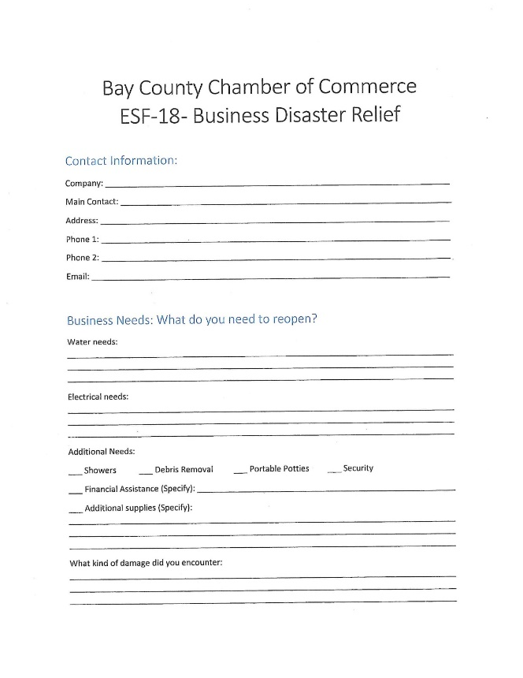

Slide 8
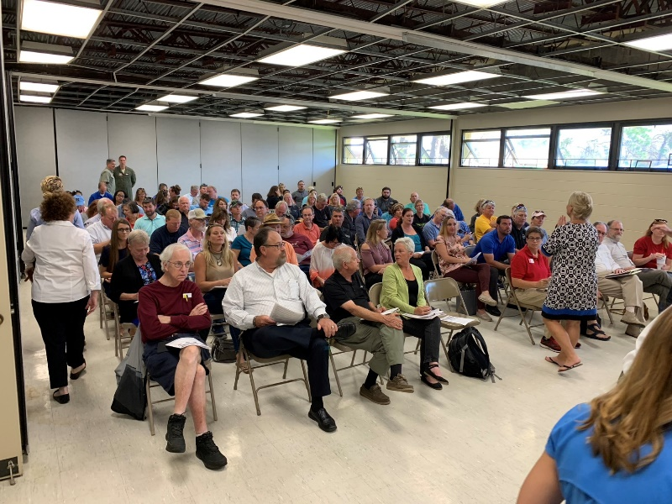
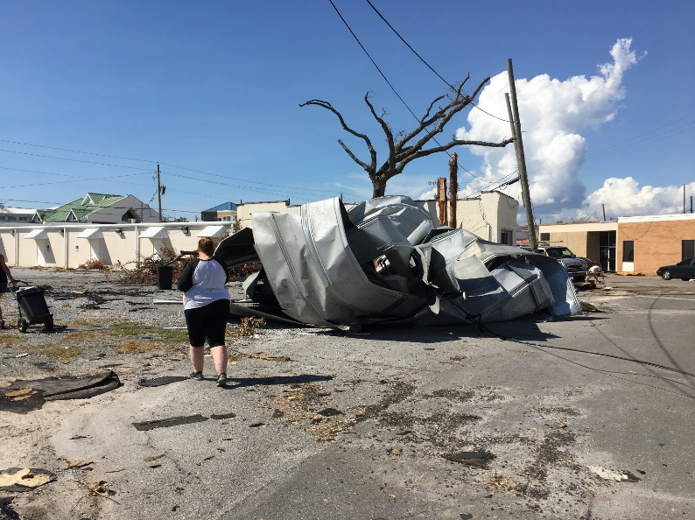
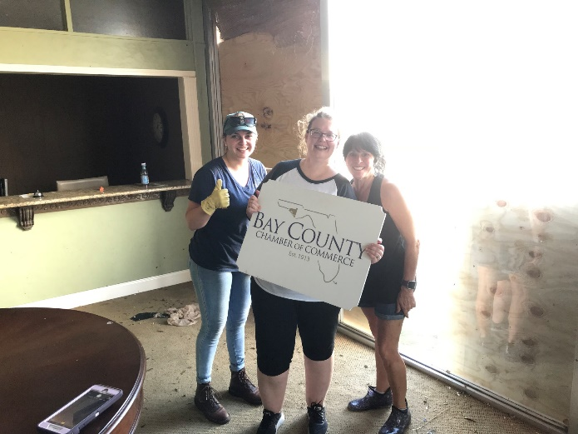

Slide 9
Lessons Learned
Business Community
Challenges
Triumphs
Notes:
We learned many lessons after the storm. In all of our surveying of businesses, we found most did not have wind coverage. Those who rented buildings or spaces never insured their contents. It is our job to keep educating our members resources that are available to them. Our loss of workforce has been a huge challenge. We lost a majority of our public housing so when residents moved away, that workforce left as well. Over 70% of public housing is no longer available. 3 schools have been closed, one high school repurposed to a 6-12. The loss of students equals a loss of revenue in our school system. While getting our building repaired, we learned so much about mitigation. First, don’t feel pressured to do business with the first company that shows up on site. Work mitigation that may need to be done through your insurance agent and verify the working relationship between insurance and the mitigation companies.
Read all your contracts. CAREFULLY. Mitigation companies will swarm in and because local workforce is in recovery mode, they will bring in people to work from neighboring towns. This will come at a premium. Some contracts will have you pay for meals, hotel rooms, even air fare of the upper management coming to town to market to businesses that may need their services.
Have your staff go into the building first, before any mitigation team to salvage anything that is needed, undamaged items to sustain events. And look far in advance. You may not be back in your building in just a few months. Next month it will be over a year since we walked out of our building.
Know where your office contents are. After the hurricane hit and so many homes and businesses were destroyed, storage units became hard to come by. We have stuff from Pensacola to Chipley.
Our challenges are like all of our other businesses. As a chamber of commerce, we have moved 3 times. First, in a conference room at the local Chevrolet dealership. Our second time, the city of Panama City loaned us space in a 5-wide modular building that we shared with other city entity’s. This last time, we have a small office set up at our local community college that houses two employees while other employees are working mobile.
Looking on the bright side, as a community, we have the ability rebuild a town of the future. Old neglected buildings are now signs of growth and change. Our Chamber is in the best financial situation then ever. Our community supports our mission and with a committed staff and board, we have been able to take advantage of the storm and grow our organization in memberships and in our events.

Slide 10
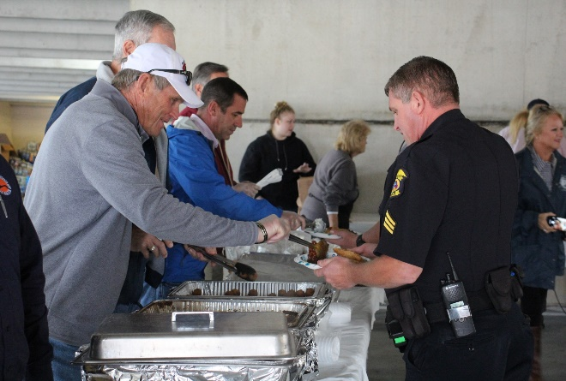
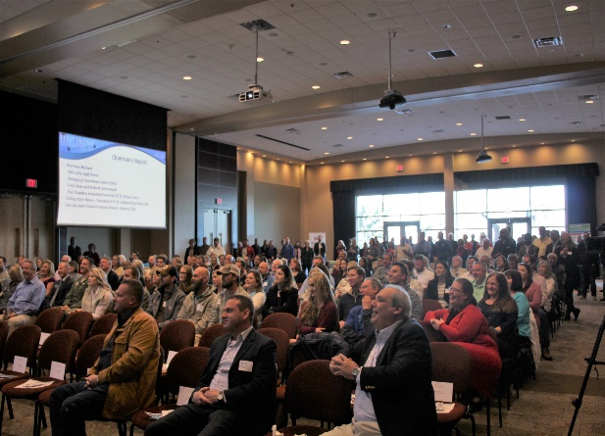
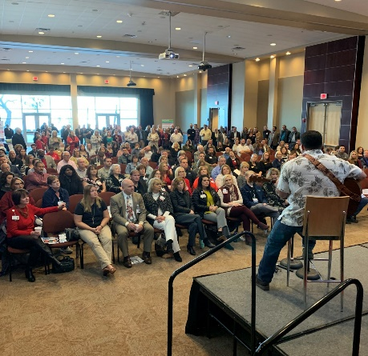
Moving Forward
Notes:
After the storm, our leadership had to make the very difficult decision on what was next for the Chamber. After seeing business after business basically a pile of rubble next to road, you figure there goes your membership and event revenue. As our community started to turn the corner, we made the decision to move forward with our First Responders Appreciation Event on November 16th. It was an annual event that had been scheduled before the storm and we had a majority of the sponsorship dollars in the bank. Instead of our typical programed event, we found an undamaged parking garage at a local church and fed every first responder in Bay County. Our task force that had been meeting before Oct. 10th had come together to deliver or serve meals. The response from our business community was overwhelming.
Our next step into moving forward was to determining when to send our next billing for membership renewals. This was not a decision that was made very lightly. After seeing the response from our First Responders event that was held in November, we decided to send out our renewal invoices in December. With each invoice that was sent, we enclosed a specially crafted message. The response from our membership was overwhelming.
Our next decision was when to start having our monthly First Friday event. This event is held at a local college that took on some damage. After discussions with the college, we moved forward to start with our December event. Usually our attendance is around 300 members. This one was over 400 people. We were seeing our community was longing to have some type of normalcy.

Slide 11
Elizabeth Smith Bay County Chamber of Commerce Elizabeth@baychamberfl.com www.panamacity.org

